Slide 1


SRM VALLIAMMAI ENGINEERING COLLEGE
(An Autonomous Institution)
SRM Nagar, Kattankulathur – 603 203.
DEPARTMENT OF INFORMATION TECHNOLOGY
1908611 – MINI PROJECT
Final Review
SPRING AI: A GPT-4 Powered Multi – Functional AI System
BATCH MEMBERS:
MANISHA S (142222205064)
PAVITHRA S (142222205075)
RAJA PRATHAP SINGH(142222205078)
SANDHIYA R (142222205089)
GUIDED BY:
Mrs. S.SHENBAGAVADIVU
ASSISTANT PROFESSOR
DEPT. OF INFORMATION TECHNOLOGY

Slide 2
BASE PAPER
Title: Q-Module-Bot: A Generative AI-Based Q&A Bot for Teaching Support
Authors: Mia Allen, Usman Naeem, Sukhpal Singh Gill
Source: IEEE Transactions on Education, Vol. 67, No. 5, October 2024
Developed a generative AI-based Q&A chatbot for module teaching support.
Uses LLMs and NLP to answer student queries in real time.
Designed for both technical & non-technical educators.
Supports modern e-learning and GPT integration in education.

Slide 3
INTRODUCTION
The aim of this project is to create a chatbot using a Spring AI.
Using OpenAI API for intelligent response based on user input.
Three Fundamental features: Image generation, recipe generation and smart query-based response.

Slide 4
OBJECTIVES
Create an interactive, all-in-one AI tool
Automate FAQs to save user time
Deliver accurate, useful responses with Generative AI
Support users across various domains like education, cooking, and creativity
Showcase AI integration with real-world applications using Spring Framework

Slide 5
LITERATURE SURVEY
Conversational AI:Chatbots
Siddhant Meshram,2021 International conference on Intelligent Technologies(CONIT) Karnataka,india. DOI:10.1109/CONIT51480.2021.9498508
ChatPapers:An AI Chatbot for interacting with Academic Research
MaxDean,Michael F.McTear,2023 31st Irish Conference on Artificial Intelligence an CognitiveScience(AICS).
DOI:10.11.09/AICS60730.2023.1047052

Slide 6
EXISTING SYSTEM
Recipes are not personalized based on user’s available ingredients.
Systems respond slowly due to reliance on database searches.
Traditional platforms lack scalability and modern AI integration.
Users need multiple platforms for text, image, and recipe functions.

Slide 7
PROPOSED SYSTEM
Fast & real-time AI responses via REST APIs.
Uses openAI’s latest models for text and image generation .
Uses Springboot auto-configuration for quick deployment
Easily scalable with Microservice architecture.
Spring security ensure API protection and user authentication.
Get AI generated recipes based on ingredients.

Slide 8
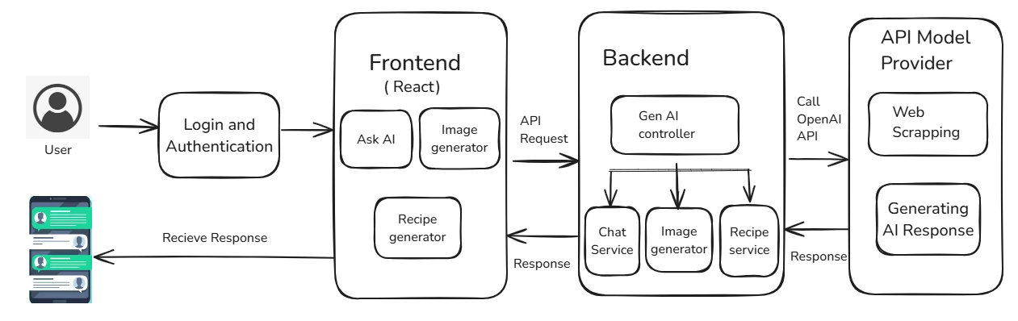
ARCHITECTURE DIAGRAM

Slide 9
HARDWARE & SOFTWARE REQUIREMENTS
Software Requirements
Backend:
Spring AI, Java, Spring Boot
Frontend: React.js
Dev Tools:
IntelliJ IDEA, Postman
Build Tool: Maven
APIs: REST, OpenAI, DALL·E
Web Server:
Embedded Tomcat (via Spring Boot)
Hardware Requirement:
Processor: Minimum Intel Core i3
or i7
RAM: 8GB
SSD: 256GB
Operating System: Windows 11

Slide 10
METHODOLOGY
Module | Algorithm Used
User query Processing | NLP(Tokenization , Text Classification)
Text Generation | Transformer Model(GPT-4)
Image Generation | Diffusion Model(DALL-E-2)
Recipe Recommendation | Content-Based Filtering
Backend Processing | RESTful API Architecture
Data Processing | Text & Image Normalization Techniques

Slide 11
MODULE 1 : User Query Processing
Handle user queries.
Uses Natural Language Processing(NLP)
Sentences are preprocessed (Tokenization, stopword removal, etc.)
Text classification using transformer models

Slide 12
MODULE 2 : AI Text Generation
Generates AI-powered responses for user queries
Works on self attention mechanism to process and generate responses.
Uses Reinforcement learning from human feedback

Slide 13
MODULE 3 : AI Image Generation
AI-based images from text prompts
DALL-E API processes the input and generate an image.
Uses denoising diffusion probabilistic models(DDPM).
Converts random noise into meaningful images based on text input.

Slide 14
MODULE 4 : Recipe Recommendation
Provide recipe suggestions based on user input.
Content –Based Filtering algorithm
Matches user ingredients with a recipe database .
Suggests best matching recipes based on keyword similarity.

Slide 15
MODULE 5 : Backend Processing & API Integration
Manages backend logic , API requests and responses.
Uses Sprigboot(springAI) to integrate openAI API’s
Data is processed and stored efficiently for better performance.
Implements request validation and authentication.

Slide 16
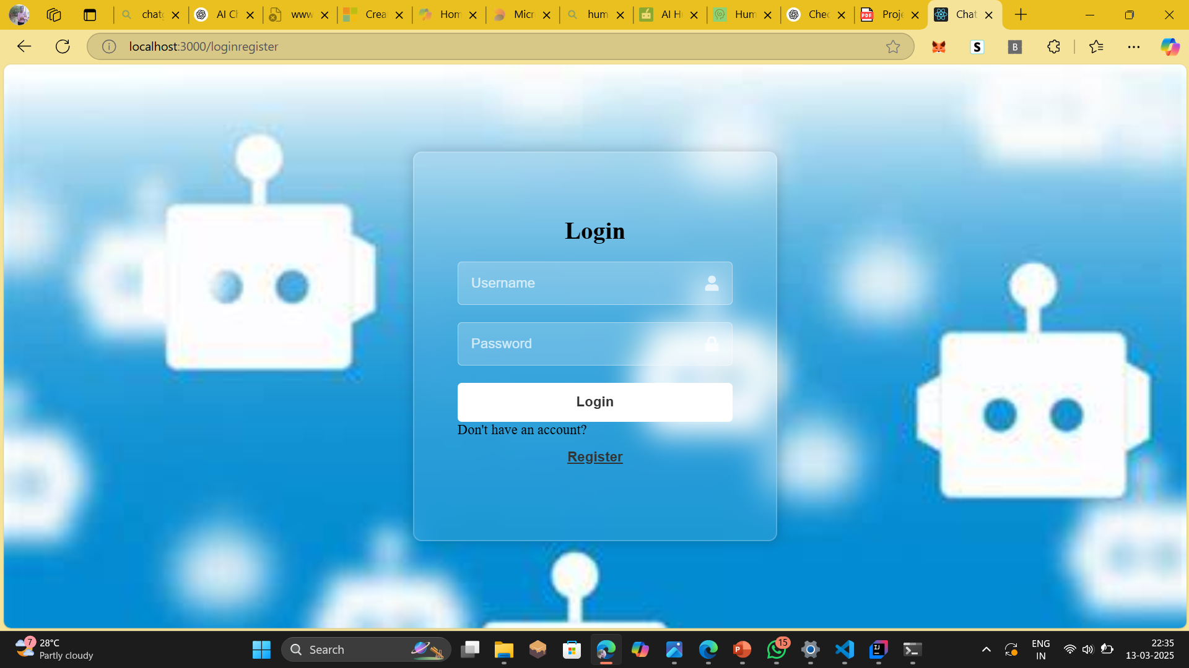
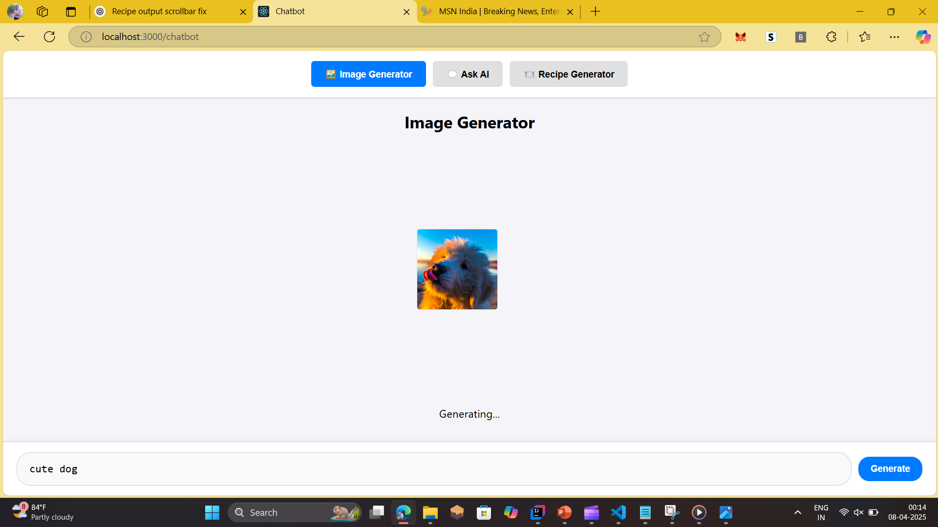
IMPLEMENTETION OF LOGIN PORTAL

Slide 17
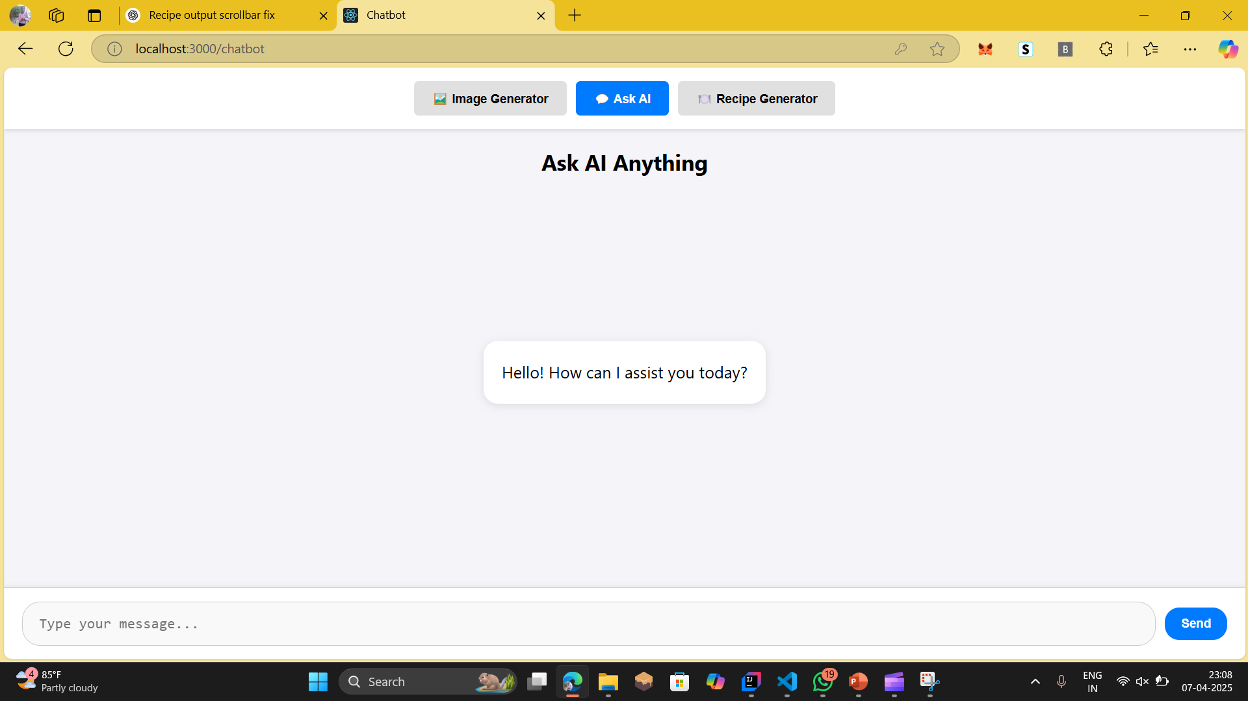
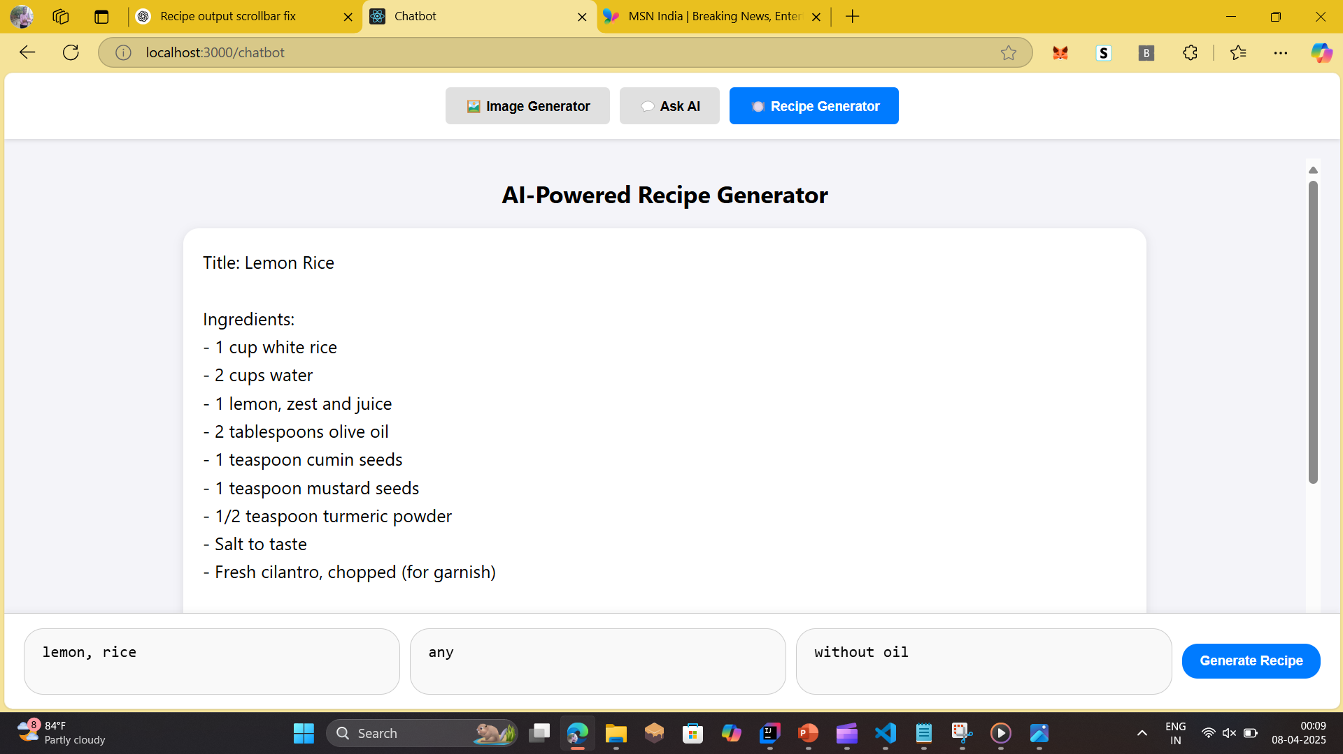
IMPLEMENTATION OF AI CHATBOT

Slide 18
REFERENCES
S. S. Gill, U. Naeem, S. Fuller, Y. Chen, and S. Uhlig, “How Covid-19 changed computer science education,” Itnow, vol. 64, no. 2, pp. 60–61, Jun. 2022.
B. R. Ranoliya, N. Raghuwanshi, and S. Singh, “Chatbot for university related FAQs,” in Proc. Int. Conf. Adv. Comput., Commun. Informat. (ICACCI), 2017, pp. 1525–1530.
V. P. Dennen, A. A. Darabi, and L. J. Smith, “Instructor-learner interaction in online courses: The relative perceived importance of particular instructor actions on performance and satisfaction,” Distance Educ., vol. 28, no. 1, pp. 65–79, 2007.
K. El azhari, I. Hilal, N. Daoudi, and R. Ajhoun, “Smart learning using autonomous Chatbot based on NLP techniques,” in Proc. Int. Conf. Artif. Intell. Smart Environ., 2022, pp. 723–728.
D. Feng, E. Shaw, J. Kim, and E. Hovy, “An intelligent discussion-bot for answering student queries in threaded discussions,” in Proc. 11th Int. Conf. Intell. User Interfaces, 2006, pp. 171–177.

Slide 19
THANK YOU

